Slide 1



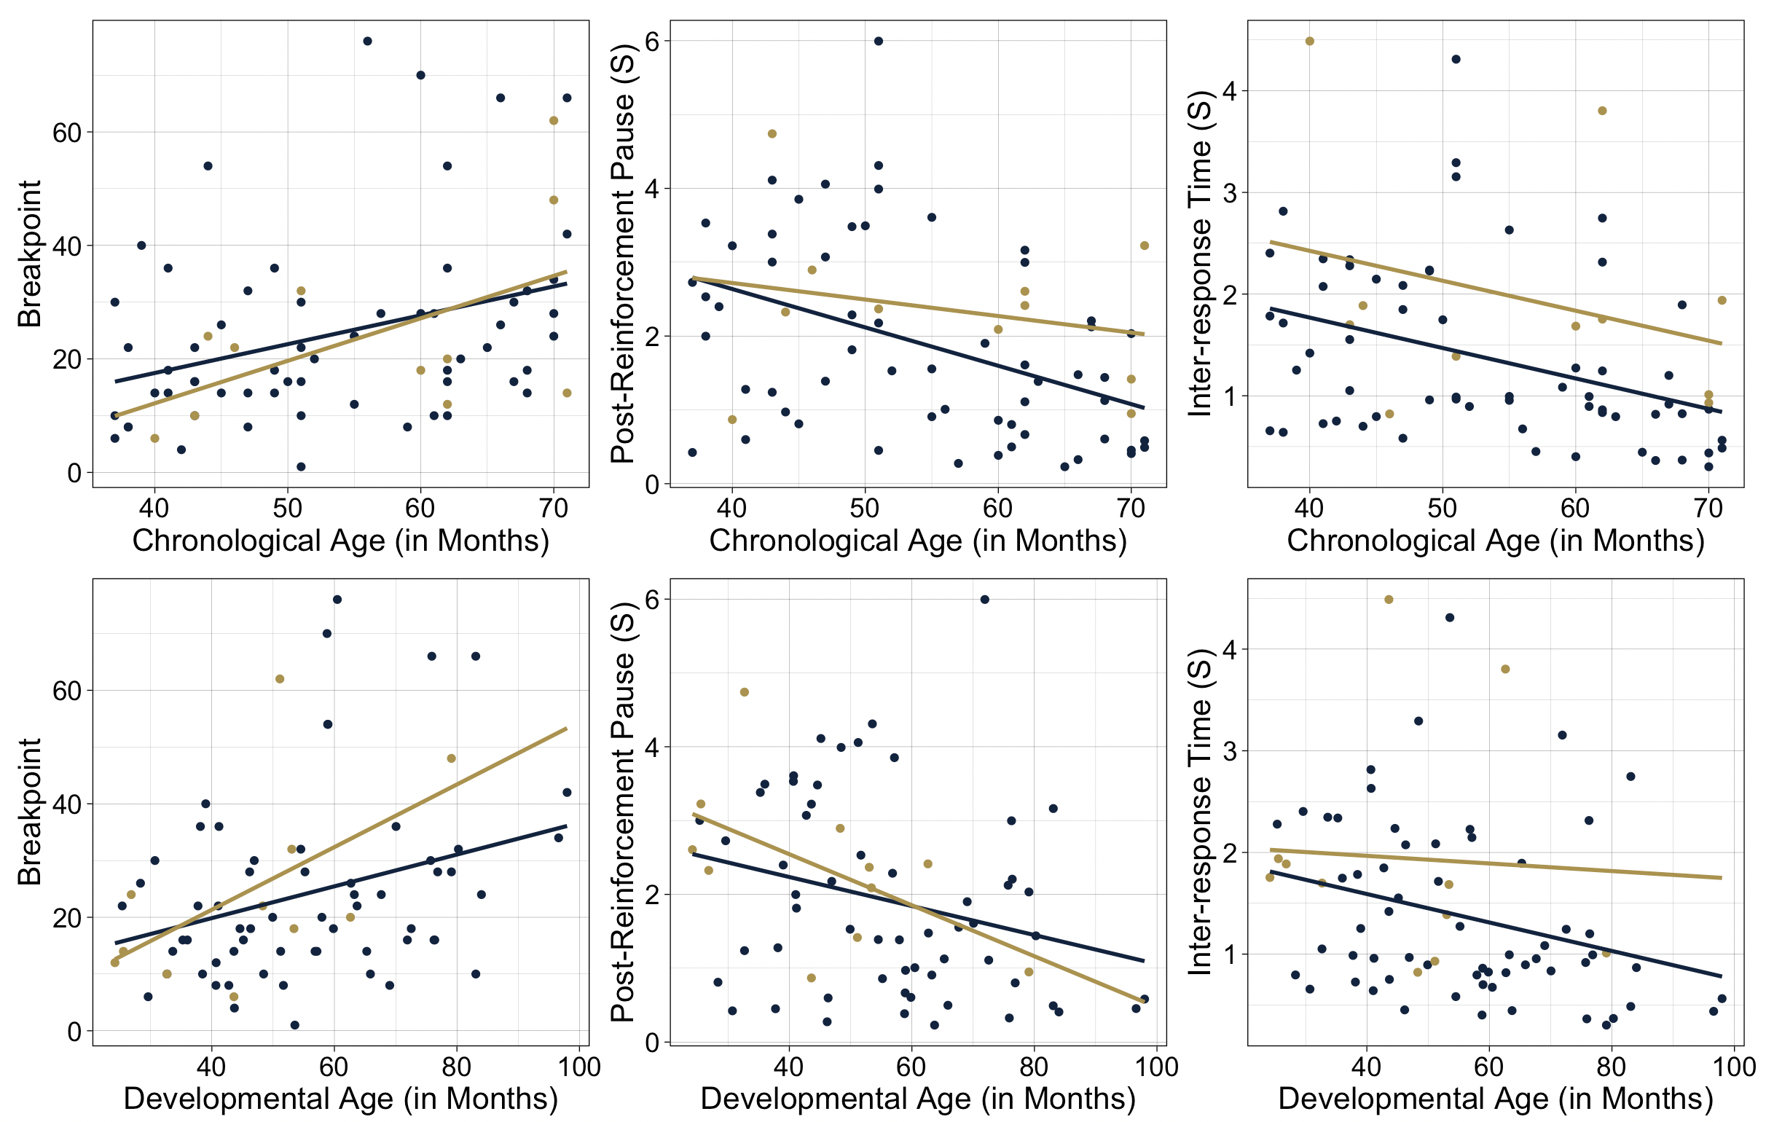
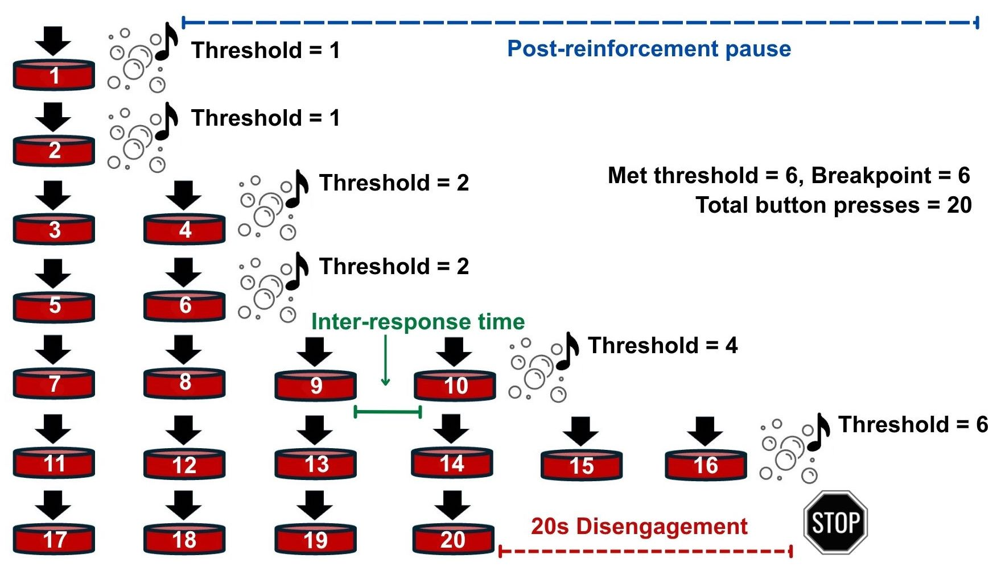
Measuring Effort in Early Childhood with a Novel Progressive Ratio Task
Mikayla McEllin, BA, Ava Batz, Elle Fox, BS, Mike Villano, PhD, Caitlin C. Clements, PhD
Department of Psychology, University of Notre Dame
Introduction:
Early interventions for autism often leverage rewarded effort to shape behavior
There is a wide variety of responses to early interventions among autistic individuals¹
Understanding individual differences in exertion of effort may inform intervention dosage recommendations and help clinicians understand how best to motivate a child, thereby promoting largest therapeutic effects
Objective:
Determine whether effort is best predicted by chronological or developmental age in autistic and non-autistic preschoolers
Results:
Methods:
PressMORE (pressing Measure Of Rewarded Effort): musical bubble machine that requires progressively more input (button presses) to elicit a reward (musical bubble display)
Diagnosis | Outcome Variable | 𝚫 AIC
Non-autistic | Breakpoint | 1.53
 | Post-reinforcement pause | 6.95
 | Inter-response time | 4.03
Autistic | Breakpoint | -0.61
 | Post-reinforcement pause | -3.18
 | Inter-response time | 1.00
All 𝚫 values represent developmental age model – chronological age model. Values >|2| considered significant.
For non-autistic children, chronological age appears to be a better predictor than developmental age for PRP and IRT with no difference in predicting BP. For autistic children, developmental age is a better predictor than chronological age for PRP with no difference in predicting BP and IRT.
Outcome Variables:
Breakpoint (BP): highest number of presses exerted (i.e., threshold) to obtain a single reward²
Post-reinforcement pause (PRP): duration of time between receiving a reward and resuming button presses
Inter-response time (IRT): duration of time between each button press
Six linear regressions were conducted to predict each outcome measure (BP, PRP, and IRT) with chronological then developmental age for both non-autistic and autistic children. Models were compared by evaluating change in AIC, with values >|2| considered to be a meaningful change³
Discussion:
Chronological age may be a better predictor of effort for non-autistic children while developmental age may be a better predictor for autistic children
Measuring effort may allow for more individualized behavior plans for autistic children, improving early intervention efficacy
Longitudinal study using pressMORE may elucidate developmental trajectory of effort
Demographics | Total | Non-autistic | Autistic
N | 72 | 61 | 11
Age(Months), Mean(SD) | 53.9(10.9) | 53.4(10.8) | 56.3(11.8)
% White | 88% | 87% | 91%
% Black | 29% | 28% | 36%
% Hispanic | 26% | 21% | 55%
% Multiracial | 19% | 16% | 36%
% Male | 46% | 46% | 45%
Acknowledgments:
This project is supported by a NARSAD Young
Investigator Grant (32408) from the Brain & Behavior
Research Foundation, and generous donors. We would
like to thank the families who participated in the
TREAT Study, lab members who collected data, &
BRAIN Lab Community Advisory Board Members.
Contact: mmcellin@nd.edu
References:
¹Warren et al., 2011, ²Hodos, 1961, ³Sutherland et al., 2023

