Slide 1

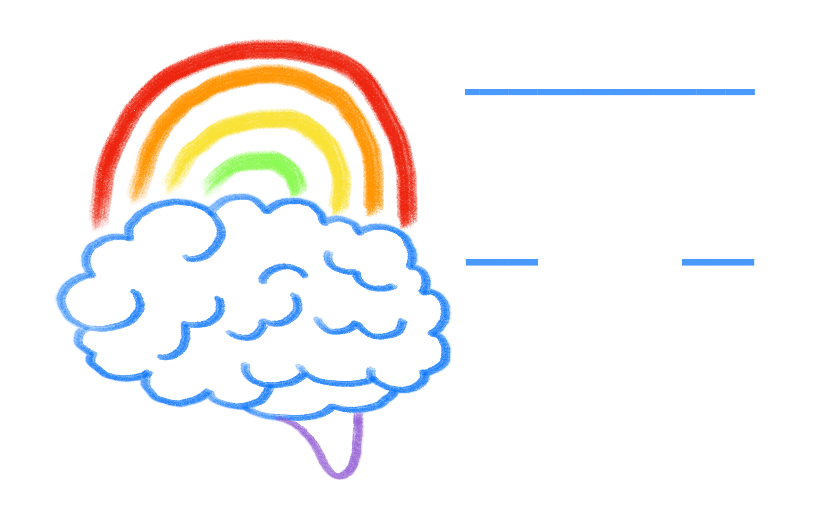
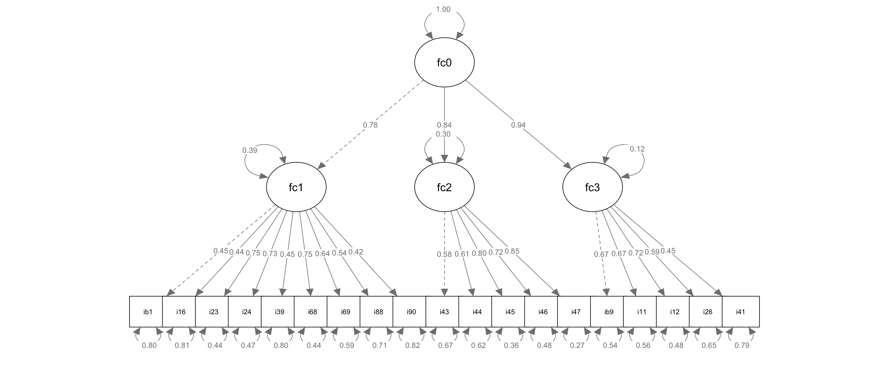
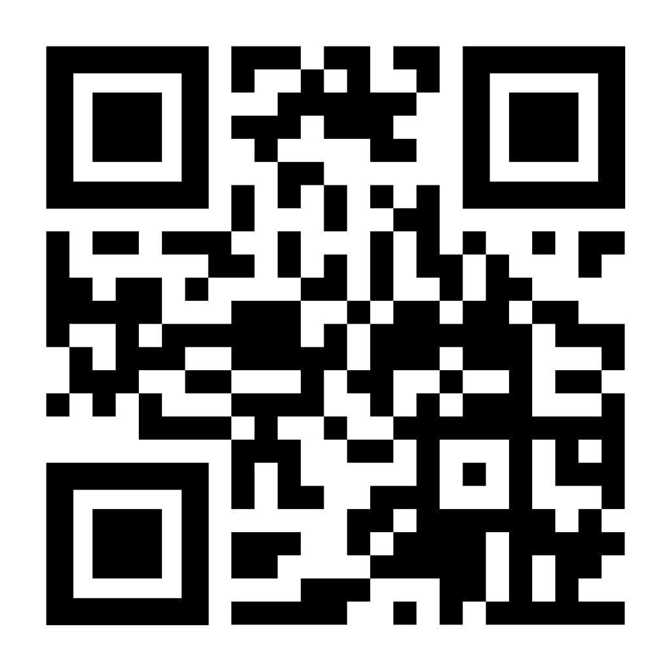
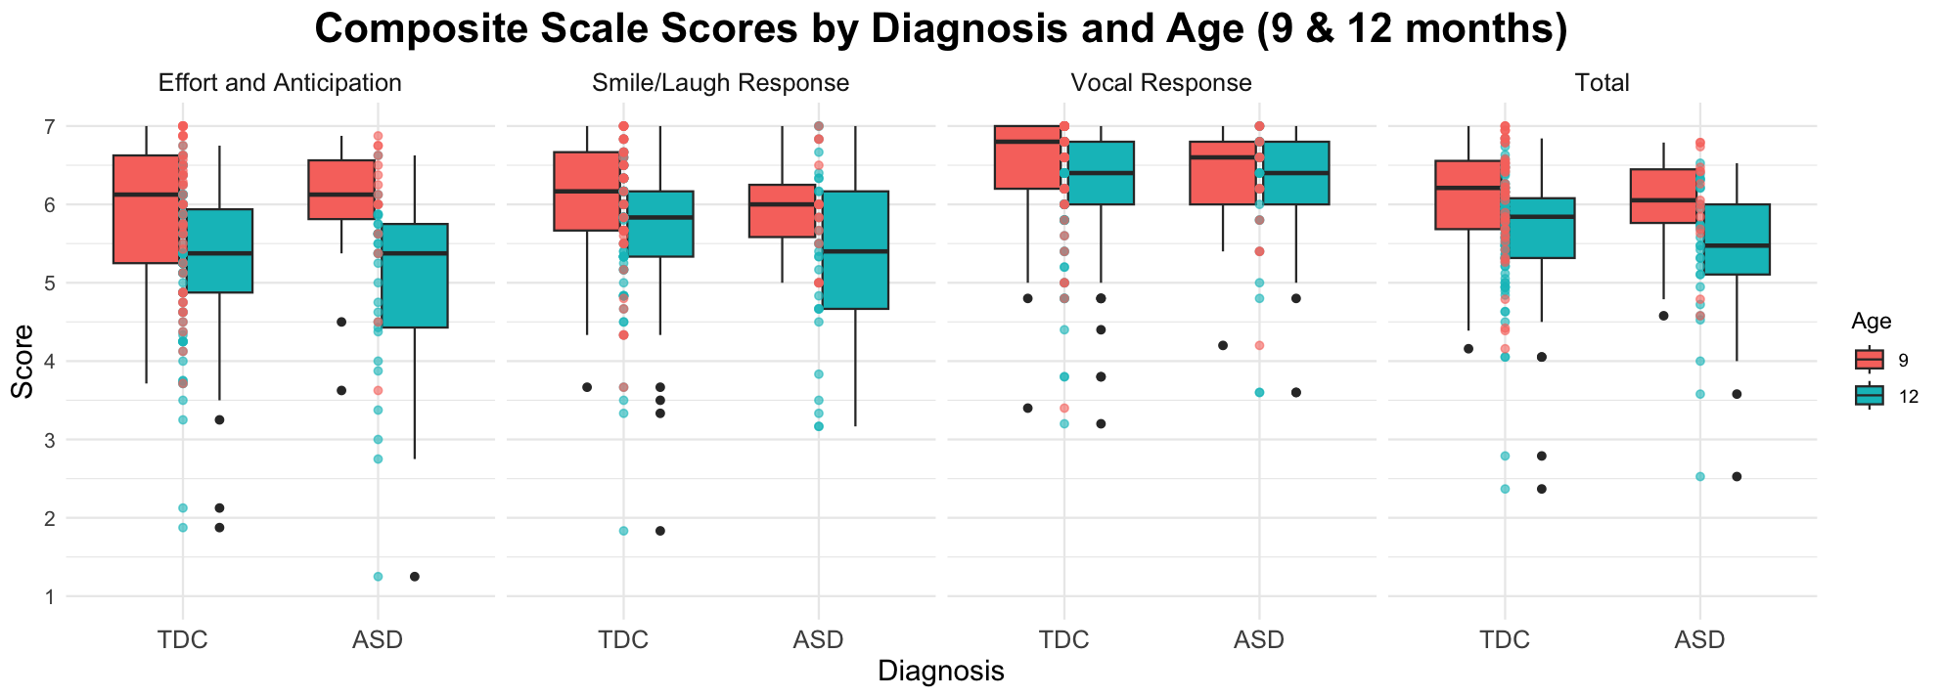
1
Developing an Infant Reward Processing Scale from
the Infant Behavior Questionnaire – Revised Short Form
Yvonne C. Kuo¹, Mikayla McEllin¹, Carol L. Wilkinson², Michelle Bosquet Enlow², Helen Tager-Flusberg³, Charles A Nelson², Caitlin C Clements¹
¹University of Notre Dame, ²Boston Children’s Hospital/Harvard Medical School, ³Boston University
f
Conclusion
Introduction
Results
Table 1. Model Fit Indices for All Models Tested
Social motivation hypothesis: school-age children, adolescents, and adults on the spectrum show diminished neural responses to rewarding social and nonsocial stimuli¹
Reward processing is commonly studied in middle childhood, adolescence, and adulthood, but rarely in infancy and toddlerhood
Precursors to social motivation may be indexed by parent-report measures²
Temperamental traits such as approach, high pleasure, and persistence could reflect how infants anticipate and respond to rewards
Infant Behavior Questionnaire Revised (IBQ-R): Commonly used, 91-item parent-report measure of temperament in infants between 3 – 12 months³
A measure that assesses reward processing in infancy might capture early differences in distinct components of reward processing that precede autism diagnosis
Objective 1:
Models | χ² | CFI | CFI | TLI | RMSEA | SRMR
Discovery* (n = 335)
29 item | 3660.15 |  | .649 | .619 | .095 | .084
26 item | 1396.07 |  | .649 | .614 | .105 | .087
24 item | 1173.81 |  | .680 | .646 | .105 | .087
23 item | 1092.69 |  | .692 | .656 | .107 | .088
22 item | 999.22 |  | .709 | .674 | .107 | .096
20 item | 698.94 |  | .780 | .750 | .098 | .087
19 item | 555.56 |  | .820 | .793 | .090 | .067
Replication* (n = 671)
19 item | 1024.69 |  | .825 | .800 | .094 | .063
*discovery and replication sample were randomly selected from total sample
A subset of 19 items from the IBQ-R, a parent-report temperament measure, were curated to form a reward processing composite score.
Factor analysis supported a 3-factor hierarchical model as the best model, with subscales that appear to tap “Effort and Anticipation,” “Smile/Laugh Response”, and “Vocal Response.”
Goodness of fit indices did not reach desired thresholds (RMSEA <0.05, CFI>0.90, SRMR<0.05); however, the conventional IBQ-R SF structure itself shows poor fit in this and other samples [cite the 2 other papers here]
No differences between TD v. ASD in Subscale 1, Subscale 3, and total score; minimal significance between TD and ASD for Subscale 2 scores (p=0.050731)
Quantifying early reward processing indexed by parent-report could offer insights into when and how reward processing diverges in autism, with applications to the motivation hypothesis as well as early intervention, which often relies on reward. Further refinement of the scale is needed
Table 2. Questions for each subscale on 19-items
Subscale | Questions
Effort and Anticipation | 1, 16, 23, 24, 39, 68, 69, 88, 90
Smile/Laugh Response | 43, 44, 45, 46, 47
Vocal Response | 9, 11, 12, 26, 41
Objectives
Curate a reward composite scale & subscales from the IBQ-R
Compare differences in reward composite scores between infants who do and do not develop ASD
Figure 1. Factor Structure and Loadings for 19 reward processing items
Table 3. Sample IBQ-R-SF questions and corresponding reward processing 2nd order factor
Future Directions
Methods
Item |  | Effort and Anticipation | Smile/Laugh Response | Vocal Response
1 | How often does your baby show a strong desire for something s/he wanted? | x
47 | During a peekaboo game, how often did the baby laugh? |  | x
26 | How often did your baby squeal or shout when excited? |  |  | x
Create different composite scale of items identified by machine learning to distinguish between ASD and TDC samples
Assess concurrent, discriminant, and predictive validity of reward composite scale by examining correlations with existing measures that may tap into reward processing (e.g. Lab-TAB)
Explore long-term trajectory of infant reward processing
Investigate how cultural, socioeconomic, and contextual factors may influence reward processing development to enrich validity of measures across different populations
Table 1. Participants (N (% male))
Study | Age | TD | ASD | DD | Total
ISP | 3 | 34 (55.9%) | 6 (83.3%) | 14 (64.3%) | 54 (61.1%)
 | 12 | 130 (54.6%) | 29 (75.9%) | 35 (62.9%) | 194 (59.3%)
BSP | 9 | 62 (46.8%) | 16 (62.5%) | 89 (58.4%) | --
Emo | 5 | 158 | 4 (75.0%)
 | 7 | 200 | 4 (75.0%)
 | 12 | 279 | 5 (80.0%)
Total |  | Xx | Xx | xx | 1050?
Note. Participants with >15% missing data were removed prior to analysis; final n=1050. Age is reported in months.
Scan for all 19 items
Objective 2:
Figure 2. Reward processing subscale scores for matched TDC and ASD samples
29 items that map effort, response, or anticipation chosen from 91 items based on agreement of 2 of 3 raters
Participants with >15% missing data excluded. Remaining missing data imputed within each age group using multiple imputation (predictive mean matching)
Repeat until fit indices show good fit
References
¹Clements, C., et al. (2018). Evaluation of the social motivation hypothesis of autism: a systematic review and meta-analysis. JAMA psychiatry, 75(8), 797-808. https://doi.org/10.1001/jamapsychiatry.2018.1100
²Marrus, N., et al. (2024). Social motivation in infancy is associated with familial recurrence of ASD. Development and Psychopathology, 36, 101–111, https://doi.org/10.1017/S0954579422001006
³Gartstein, M. A., & Rothbart, M. K. (2003). Studying infant temperament via the Revised Infant Behavior Questionnaire. Infant Behavior and Development, 26(1), 64–86. https://doi.org/10.1016/S0163-6383(02)00169-8
Determine # of factors from scree plot
Exploratory Factor Analysis (EFA)
Remove items with loading < 0.2
Identify which items load onto which factors
(no crossloading)
Confirmatory Factor Analysis (CFA)
Acknowledgements
Fit EFA structure
to CFA
(no crossloading)
Check Fit Indices
(CFI, TLI, RMSEA, SRMR)
Remove items with low loadings or low within-factor item-total correlation
NIDCD R01DC010290; NIMH MH078829; Tommy Fuss Center for Neuropsychiatric Disease Research; Department of Psychiatry and Behavioral Sciences, Boston Children’s Hospital; Eagles Autism Foundation; NINDS #1R01NS120986; RedCap
For comparisons between ASD and Typically Developing Children, ASD participants were matched to TDC (1:3) on age and sex, then compared on each novel reward subscale with MANOVA.
No significant differences were observed between ASD and TDC groups on any subscale after correcting for multiple comparisons.
Contact: ykuo3@nd.edu
Notes:
Factor 1 effort and anticipation
Factor 2 smile and laugh response
Factor 3 vocal response

