Slide 1


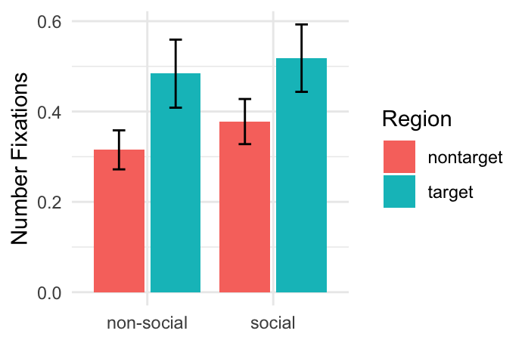
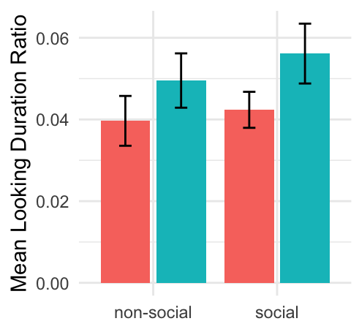
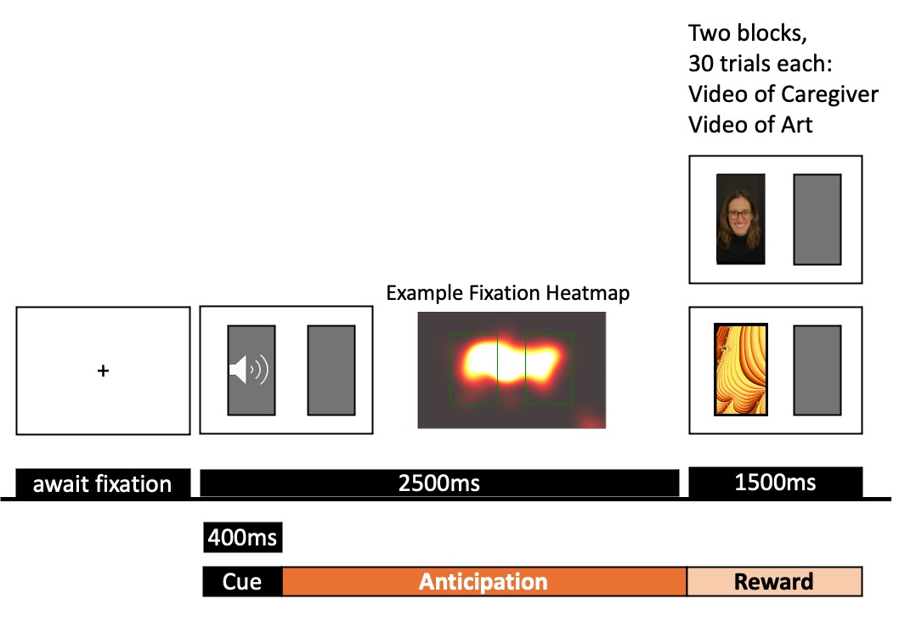
ePeekaboo: a novel eye-tracking paradigm to track the development of contingency learning and anticipation
Zhiwei Yu¹, Mikayla McEllin², Ningxin Kong¹, Yvonne C. Kuo², Zhi Zheng¹, Caitlin C Clements²
¹College of Engineering, University of Notre Dame ²Department of Psychology, University of Notre Dame
Introduction
Alterations in reward processing are consistently reported in autism, ADHD, and neurodevelopmental conditions [1]
Common tasks (Doors Guessing, Incentive Delay) require complex cognition and button presses. The lack of passive tasks suitable for infants hinders our understanding of the early development of reward processing.
Passive eye-tracking tasks can index components of reward processing in infancy [2,3]
ePeekaboo is a passive eye-tracking designed to measure contingency learning and anticipation through anticipatory saccades.
Longitudinal, developmental study of two components of reward processing – contingency learning and anticipation – could inform our understanding of the early development of social motivation in autism [1]
Results
Discussion
Participants correctly anticipated where the video would appear after the sound cue, based on looking patterns to the target side (more fixations and longer fixation duration). These results suggest ePeekaboo may be able to measure anticipation and contingency learning in 3-5yos.
Contrary to hypotheses, anticipatory looking decreased over the 60 trials. Participants may habituate or become bored and fussy during the ~10 minute experiment.
Looking patterns did not differ significantly between social and nonsocial conditions, but larger samples are needed.
Tables 2 & 3. Model Results.
1. After the sound cue, do children show anticipatory looking to the target side where the video will appear?
Answer: Yes, significant effect of Target.
  True for caregiver video block and nonsocial video block, for both number and duration of fixations.
2. As the experiment progresses, do children increase anticipatory looking to the target side (i.e., the side predicted by sound)?
Answer: No; negative effect of Trial Number.
  Number and duration of fixations decreased across trials.
 | Number of Fixations
Predictors | Beta | SE | CI | t | p
Intercept | 0.372 | 0.064 | 0.246 – 0.498 | 5.782 | <0.001
Target (vs. Nontarget) | 0.200 | 0.061 | 0.081 – 0.319 | 3.297 | 0.001
Non-social (vs. Control) | 0.254 | 0.086 | 0.085 – 0.423 | 2.940 | 0.003
Social (vs. Control) | 0.145 | 0.057 | 0.033 – 0.256 | 2.546 | 0.011
Trial Number | -0.005 | 0.001 | -0.007 – -0.002 | -4.018 | <0.001
Target × Non-social | -0.031 | 0.070 | -0.169 – 0.106 | -0.447 | 0.655
Target × Social | -0.060 | 0.070 | -0.197 – 0.078 | -0.851 | 0.395
 | Fixation Duration (Ratio)
Predictors | Beta | SE | CI | t | p
Intercept | 0.049 | 0.007 | 0.035 – 0.063 | 6.763 | <0.001
Target (vs. Nontarget) | 0.018 | 0.007 | 0.004 – 0.031 | 2.476 | 0.013
Non-social (vs. Control) | 0.019 | 0.010 | -0.001 – 0.039 | 1.887 | 0.059
Social (vs. Control) | 0.006 | 0.007 | -0.007 – 0.019 | 0.913 | 0.361
Trial Number | -0.000 | 0.000 | -0.001 – -0.000 | -3.141 | 0.002
Target × Non-social | -0.008 | 0.008 | -0.024 – 0.008 | -0.936 | 0.349
Target × Social | -0.004 | 0.008 | -0.020 – 0.012 | -0.459 | 0.646
Objectives
To determine whether ePeekaboo measures anticipation and contingency learning using eye-tracking
To assess differences in anticipation to videos of a caregiver (social) or abstract art (nonsocial)
3. Do participants show more anticipation during social than nonsocial blocks?
Answer: No. No significant interactions.
Limitation & Future Directions
Increase sample size; explore gender and age as covariates
Collect matched autistic sample
Integration of Event-Related Potential data to assess neural anticipation and response to reward
Methods
Fixation Duration (Ratio)
Participants: 33 typically developing 3-5-year-olds (Table 1)
Eye Tracking
Data recorded by 120Hz Tobii Pro Fusion eyetracker [4]
Fixations extracted using dispersion-threshold algorithm for fixation identification (I-DT). Angular threshold of 0.5° and minimum duration threshold of 300ms
Anticipatory Looking
Number of Fixations to target: Number of fixations to the target side during the 2500ms anticipation period
Fixation Duration (ratio): total duration of fixations to target door / duration of fixations during 2500ms anticipation period
Analysis
Linear mixed effects model implemented with lme4 in R
Number Fixations ~ β₀ + β₁*Target + β₂*Condition + β₃(Target*Condition) + β₄ Trial Number + 1|StudyID + ε_{ij​}
Fixation Duration ~ β₀ + β₁*Target + β₂*Condition + β₃(Target*Condition) + β₄ Trial Number + 1|StudyID + ε_{ij​}
ePeekaboo
Table 1. Demographics
 |  | n | %
N |  | 33
Male |  | 14 | 42
Age (months)
 | Mean(SD) | 54.6 (11.4)
 | Range | 36–71
Race
 | White | 24 | 75.0
 | Black | 7 | 21.2
 | Multi-race | 4 | 6.2
Ethnicity
 | Hispanic | 4 | 12.1
 | Not Hispanic | 29 | 87.9
References
1, Clements, Ascunce, and Nelson. J Am Acad Child Adolesc Psychiatry, s0890-8567. (2023).
2 Chakrabarti B, Haffey A, Canzano L, Taylor CP, McSorley E (2017) PLoS ONE 12 (10): e0185146
3 Hinz JR, Eikeseth FF, Chawarska K, & Eikeseth, S (2025). Autism Research, 17(2), 2628-2644.
4 Tobii Pro. (2023). Tobii Pro Fusion 120Hz eyetracker.
Designed to mimic peekaboo
Sound A or B plays to cue the infant that their caregiver’s video will soon appear on the left (sound A) or right (sound B).
Acknowledgements
Families who generously gave their time, BRAIN Lab Community Advisory Board, student assistants who helped with data collection, and the NARSAD Young Investigator Grant from the Brain & Behavior Research Foundation.
Anticipatory Looking
Figure 1. ePeekaboo paradigm
Contact: ykuo3@nd.edu
Notes:
Duration: duration of looking decreases across trials
(Trial effect: β = -0.0004, SE = 0.0001, t = -3.14)
NumFix: # of fixations decreases across trials (due to habituation?) (Trial effect: β = -0.005, SE = 0.001, t = -4.02)
Eyetracker: 120Hz Tobii Pro Fusion eyetracker [4]

